Slide 1





COGNITION
Data Structure
And
Competitive Programming
C++

Slide 2
BASIC C++ Program
Header File
#include<iostream.h>
using namespace std;
void main()
{
cout<<“Welcome to MTC DS and CP pathshaala”;
}
Pre-processor Directive
Main function
No return Value
End of a Statement
To print on the output screen

Slide 3

First c++ program
#include <iostream> using namespace std; int main() { cout << "Hello World!"; return 0; }

Slide 4
Line 1: #include <iostream> is a header file library that lets us work with input and output objects, such as cout (used in line 5). Header files add functionality to C++ programs.
Line 2: using namespace std means that we can use names for objects and variables from the standard library.
Line 3: Another thing that always appear in a C++ program, is int main(). This is called a function. Any code inside its curly brackets {} will be executed.

Slide 5
Line 4: cout (pronounced "see-out") is an object used together with the insertion operator (<<) to output/print text. In our example it will output "Hello World".
Note: Every C++ statement ends with a semicolon ;.
Line 5: return 0 ends the main function.
Line 6: Do not forget to add the closing curly bracket } to actually end the main function.

Slide 6
Header file
C++ language has numerous libraries that include predefined functions to make programming easier. In C++ language, header files contain the set of predefined standard library functions. Your request to use a header file in your program by including it with the C++ pre-processing directive “#include”.
There are of 2 types of header file: Pre-existing header files: Files which are already available in a C++ compiler we just need to import them.
User-defined header files: These files are defined by the user a. and can be imported using “#include”.

Slide 7
SYNTAX :
#include <filename.h>
or
#include "filename.h”
This is how you can include any header file in your program.

Slide 8
EXAMPLE OF DIFFERENT HEADERFILE IN C++
#include<iostream>: It is used as a stream of Input and Output using cin and cout.
#include<string.h>: It is used to perform various functionalities related to string manipulation like strlen(), strcmp(), strcpy(), size(), etc.
#include<math.h>: It is used to perform mathematical operations like sqrt(), log2(), pow(), etc.

Slide 9
OUTPUT AND INPUT FUNCTION IN C++
#include<iostream>//input output header file header file is the address of functions
using namespace std;
int main(){// this is the main function inside which main code come's this function is initiated automatically
cout<<"Enter you age\n";//used to show output on the screen
int n;
cin>>n;// cin is used to take input and save the input value to a variable
cout<<n;
}

Slide 10
C++ Comments
Single-line Comments
Single-line comments start with two forward slashes (//).
Any text between // and the end of the line is ignored by the compiler (will not be executed).
This example uses a single-line comment before a line of code:
EXAMPLE
// This is a comment cout << "Hello World!";
.
.

Slide 11

MULTI -LINE COMMENTS
C++ Multi-line Comments
Multi-line comments start with /* and ends with */.
Any text between /* and */ will be ignored by the compiler:
EXAMPLE
/* The code below will print the words Hello World! to the screen and this is a multiple line comment */ cout << "Hello World!";

Slide 12
C Keywords
Keywords are predefined, reserved words used in programming that have special meanings to the compiler.
These keywords cannot be used as identifiers (in other words) names of variables, functions, etc.
Identifiers
Rules for naming identifiers
A valid identifier can have letters (both uppercase and lowercase letters), digits and underscores.
The first letter of an identifier should be either a letter or an underscore.
You cannot use keywords like int, while etc. as identifiers.
There is no rule on how long an identifier can be. However, you may run into problems in some compilers if the identifier is longer than 31 characters.
Variables
In programming, a variable is a container to hold data. A variable can be of various data types.

Slide 13
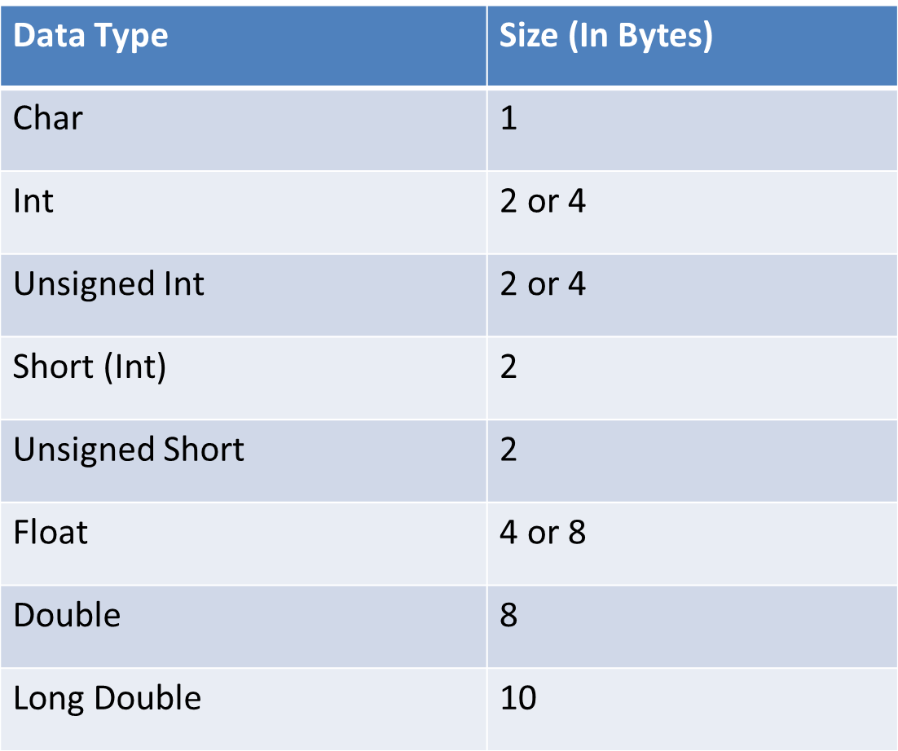
Data types

Slide 14
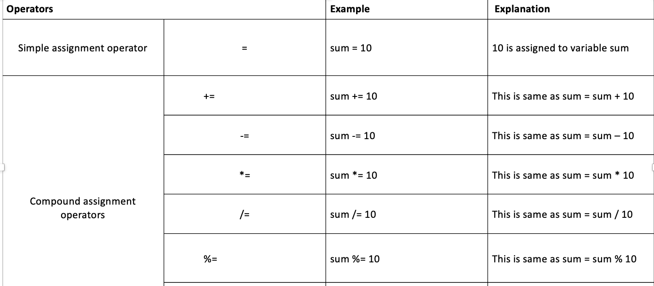
Arithmetic Operators in C:

Slide 15
Relational operators in C:
S.no | Operators | Example | Description
1 | > | x > y | x is greater than y
2 | < | x < y | x is less than y
3 | >= | x >= y | x is greater than or equal to y
4 | <= | x <= y | x is less than or equal to y
5 | == | x == y | x is equal to y
6 | != | x != y | x is not equal to y

Slide 16
Logical operators in C:
S.no | Operators | Name | Example | Description
1 | && | logical AND | (x>5)&&(y<5) | It returns true when both conditions are true
2 | || | logical OR | (x>=10)||(y>=10) | It returns true when at-least one of the condition is true
3 | ! | logical NOT | !((x>5)&&(y<5)) | It reverses the state of the operand “((x>5) && (y<5))” If “((x>5) && (y<5))” is true, logical NOT operator makes it false

Slide 17
If Statement:
if statement is the most simple decision-making statement. It is used to decide whether a certain statement or block of statements will be executed or not i.e if a certain condition is true then a block of statement is executed otherwise not.
Syntax:
if(condition)
{
// Statements to execute if
// condition is true
}

Slide 18
If else:
The if statement alone tells us that if a condition is true it will execute a block of statements and if the condition is false it won’t. But what if we want to do something else if the condition is false. Here comes the C else statement. We can use the else statement with if statement to execute a block of code when the condition is false.
if (condition)
{
// Executes this block if
// condition is true
}
else
{
// Executes this block if
// condition is false
}

Slide 19
Nested if:
A nested if in C is an if statement that is the target of another if statement. Nested if statements mean an if statement inside another if statement. Yes, both C and C++ allow us to nested if statements within if statements, i.e, we can place an if statement inside another if statement.
Syntax:
if (condition1)
{
// Executes when condition1 is true
if (condition2)
{
// Executes when condition2 is true
}
}

